Slide 1

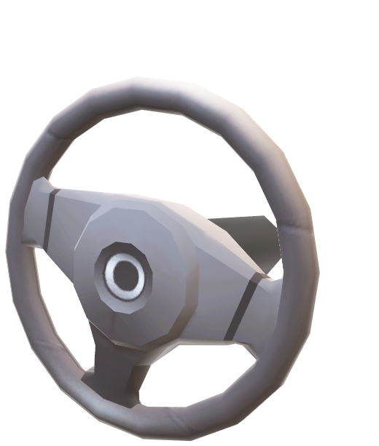
Project Guide :Er. Amit Kumar
INSTITUTE OF ENGINEERING & TECHNOLOGY, LUCKNOW
Department of Electronics and Communication
Project Group Members:
MUKIL KUMAR 1900520310036
AALOK NAUTIYAL 1900520310001
NAMAN SINGH 1900520310038
AKHAND AGGRAWAL 1900520310010
OPTICAL ENCODER STEERING SYSTEM
1

Slide 2
!ABSTRACT
Due to increase in technology humans becomes addicted to it. The technology which is been build earlier has modified and redeveloped to form a new one with less efforts, better results, less weight, high resolution and precise control. In this paper we are developing such system which will eliminate the weight and increase the precise control of the steering system.
With the help of quadrature rotary encoder, we are going to record the rotation of the steering, this record is then processed and used to control the hydraulic system. The Hydraulic system is connected to the Ackermann steering mechanism where for each degree of rotation of steering wheel there is a result in movement of hydraulic piston. This will create the wheels to rotate back and forth using steering.

Slide 3
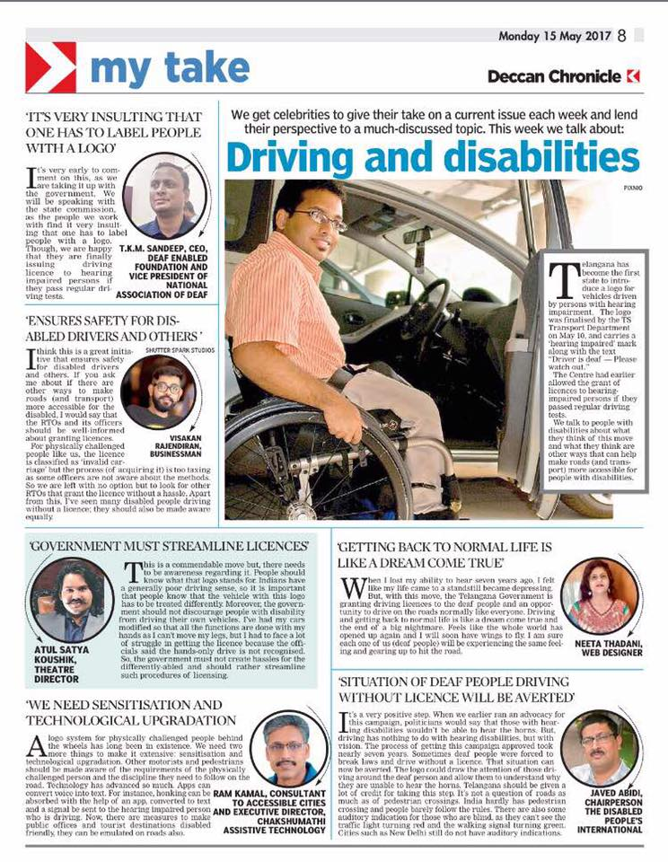
MOTIVATION
DRIVING ACCESSIBILITY FOR SPECIALY ABLED PEOPLES
1. Till now we design & made for the people the way we would like them to be !
Not for the way they really are !!
2. Autonomy is possible at level 5th
3. Power efficiency is increased
4. Advance Gaming Extensions
A BIG LEAP IN
E-VEHICLES

Slide 4
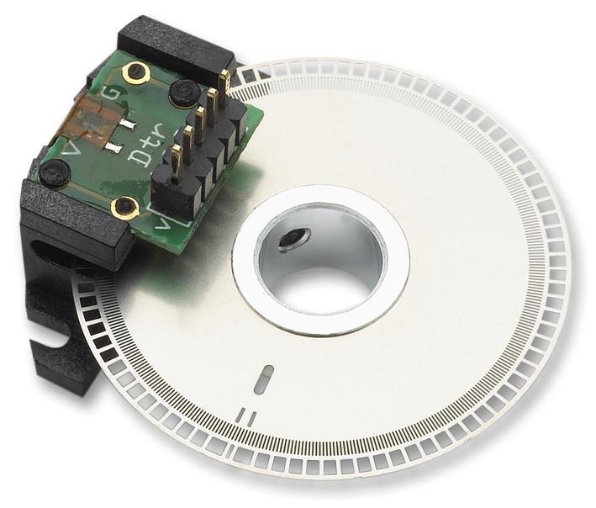
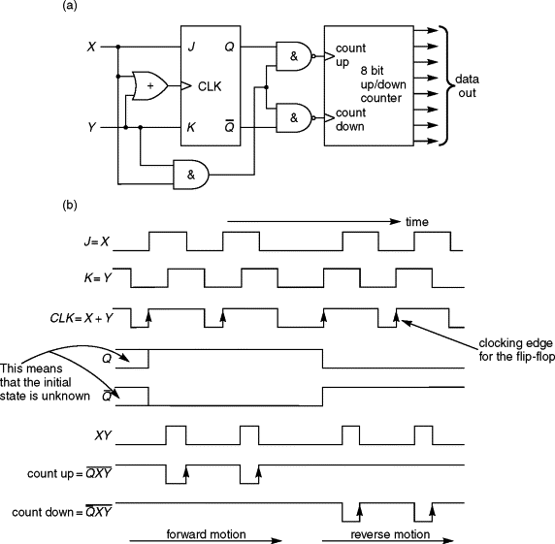
Incremental encoder (quadrature)
photodiode
Coded disc
Signal converter

Slide 5
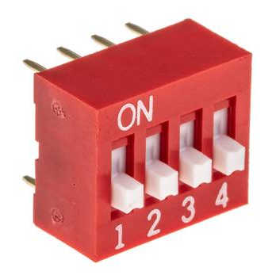

Gear shifter
The APEM type DIP( Dual in line Package) switch array is used as gear shifter in the prototype system.

Slide 6
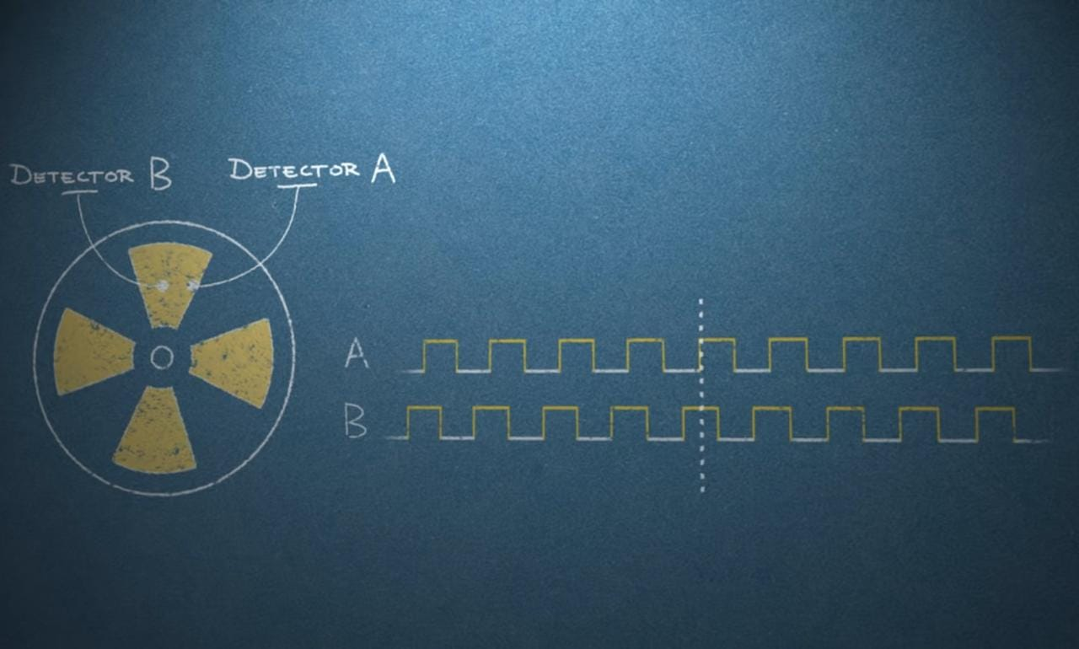
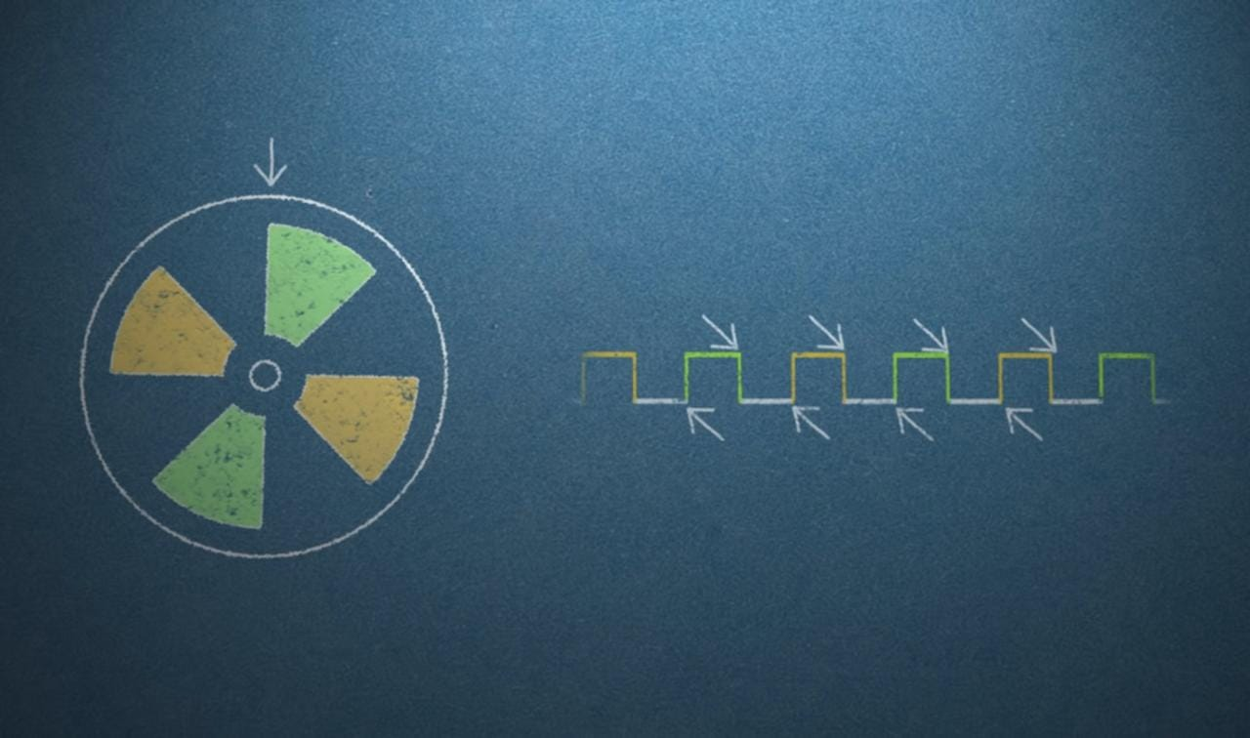
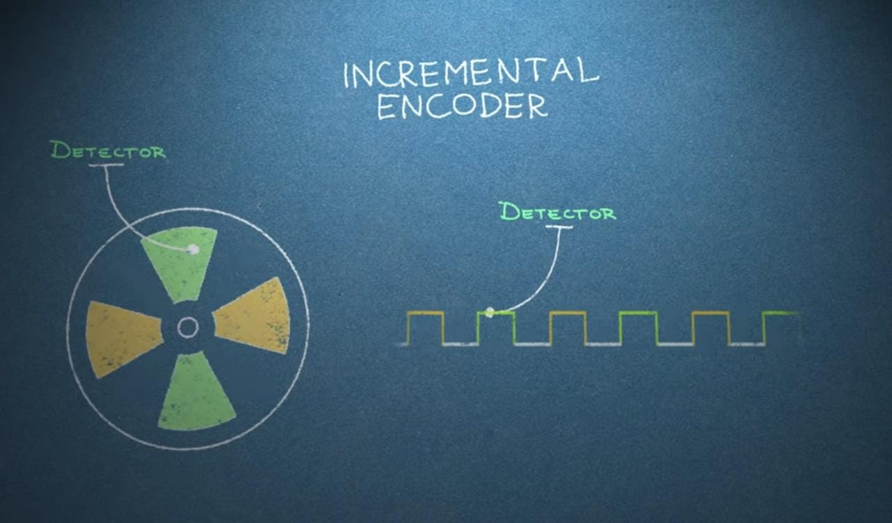
Incremental encoder (quadrature)

Slide 7
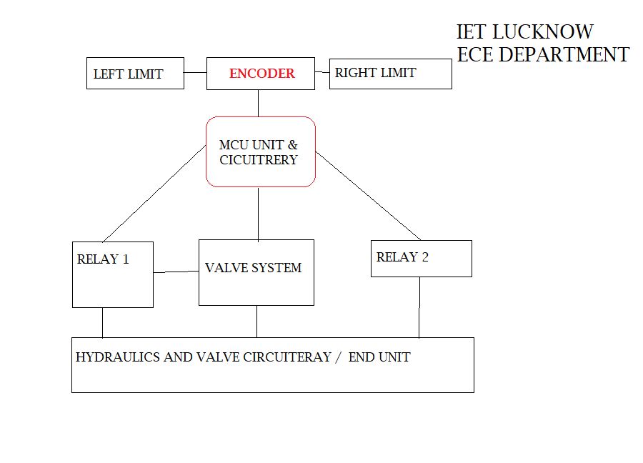
Close loop feedback based system

Slide 8
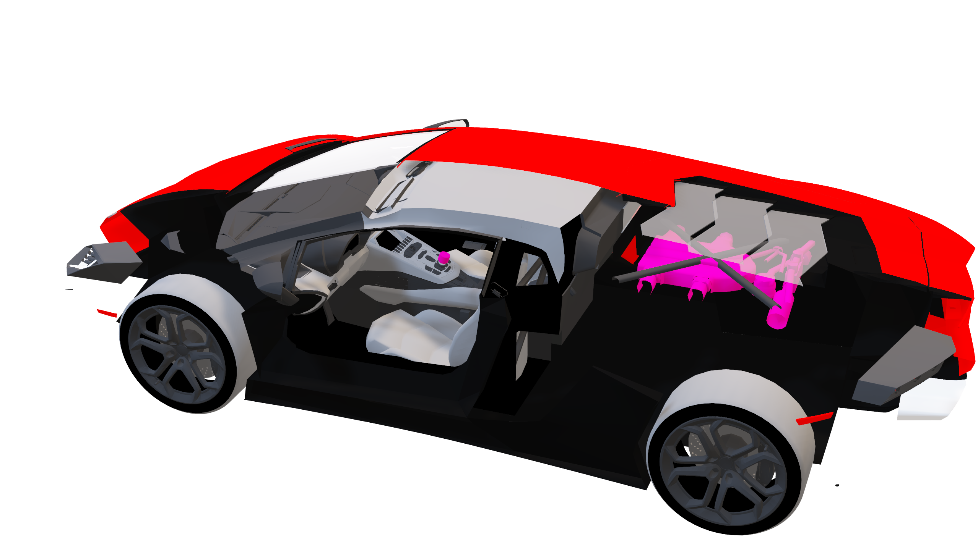
Implementation
MODULARITY, HIGH PRECISION

Slide 9

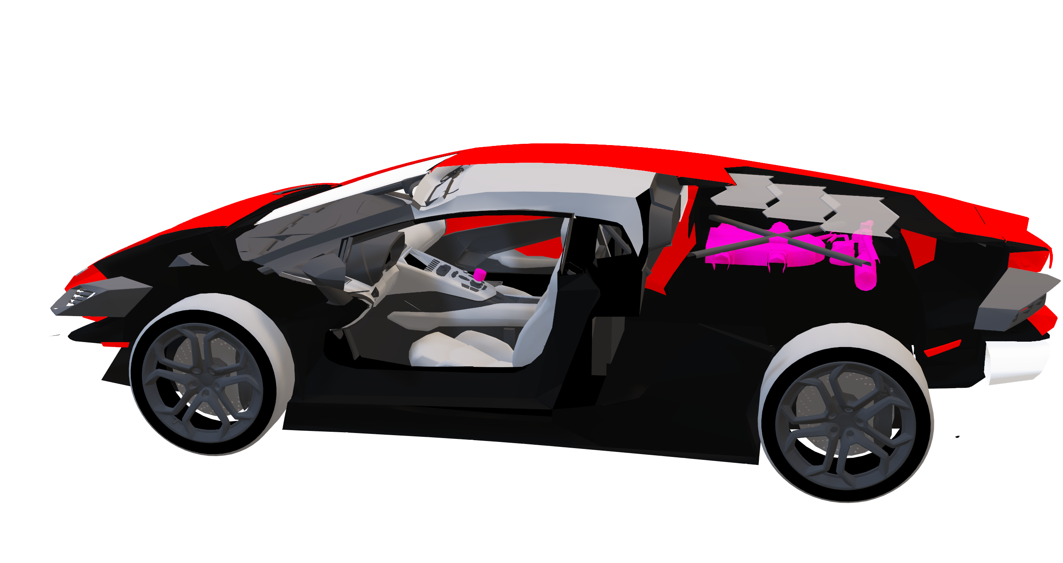
CUSTOMISATION
REPLACED STEERING WHEEL WITH OPTICAL MODULER ENCODER
SYSTEM

Slide 10
COST ESTIMATION
OPTICAL ENCODER(600PPR)
AVR32U4/M0+ CORTEX(CPUs) Specification
Rs-2700
21 mm × 51 mm form factor.
RP2040 microcontroller chip designed by Raspberry Pi in the UK.
Dual-core Arm Cortex-M0+ processor, flexible clock running up to 133 MHz.
264kB on-chip SRAM.
2MB on-board QSPI flash.
Rs-1600, Rs-600
Potentiometer
LEDs, jumper wire, Pedals(costly)
Misc.
Rs-2000
Custom PCB Board
Rs-200
Pullup Resistor network
SEREIAL COMM. CONNECTORS
Approx – Rs 8000/
Rs-50
Rs-500

Slide 11




Headers and HID code

Slide 12

Testing as hid device
Ai-wave HID supported utility software

Slide 13
CONCLUSION
Minimal space-usage and no permanent modification to the vehicle
Should be able to handle parking and low speed maneuvers safely
1. The long shaft of the steering wheel is eliminated. Due to the encoder fixed near to the steering wheel.
2. There is precise control available due the high resolution of the encoder.
3. More the resolution more the accuracy of the steering mechanism.
4. Weight of the system is reduced.
5.DRIVING ACCESSIBILITY FOR SPECIALY ABLED PEOPLES
5. Cost of manufacturing and assembly is increased due to electronic component.
6. Autonomous driving system is possible due to introduction of the encoder.

Slide 14
BIBLIOGRAPHY
[1] Carl Legelius. Minns du saaben utan ratt - ersatt av joystick? Svenska Dagbladet, 3(19), 2019.
[2] Paul Yih. Steer-by-wire: Implications for vehicle handling and safety, 2005.
URL http://www-cdr.stanford.edu/dynamic/bywire/ dissertation.pdf.
Visited 2 December 2022.
[3] Jonathan M. Gitlin. Why you’ll never drive your car with a joystick. Ars
Technica, 6(25), 2014.
[4] Six-sigma. Fmea - failure mode and effect analysis, 2020. URL http:// www.six-sigma.se/FMEA.html. Visited 28-December 2022.

Slide 15



THANK YOU
“ YOU CAN NOT DESCRIBE PASSION YOU CAN ONLY LIVE IT”

